Slide 1

Evaluating the impact of read length on RNAseq based differential expression using Galaxy and Searchlight.
Mahesh Rani Kamilus
2805500k
M.Sc. – Biotechnology
Supervised by Dr. Pawel Herzyk

Slide 2
What is RNA seq?
RNA-seq reveals gene expression to gain an understanding across diverse conditions.
Gene expression, disease mechanisms, biomarkers, personalized medicine, developmental biology.
What are reads?
DNA sequence in the form of short fragments.
Read length impacts RNA-seq accuracy, sensitivity, and resolution significantly.
Sequencing cost lowered post-2003 human genome completion.
Illumina tech produces short reads of variable lengths, varying consumer costs.

Slide 3
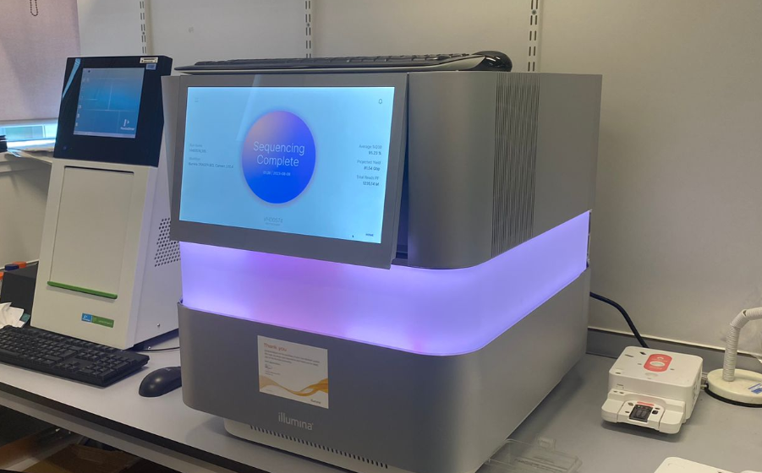
What is the goal of the study?
Golden standard
Glasgow Polyomics upgraded to NextSeq 2000; 2x75bp replaced with 2x100bp due to compatibility.
Illumina introduced sequencing kits (50, 100, and 200 cycles) for NextSeq 2000.
Both 100 & 50 cycles have 38 cycle redundancy and 20 cycles reserved for sample barcoding.
100 cycles 50 cycles
(100+38)-20 =118 (50+38)-20=68
2x59 2x34
So, 100 cycles kit can produce 2x59bp ,and 50 cycles kit can produce 2x34bp.
Our study focuses on
100 cycles and 50 cycles are cost-effective alternative to the 200 cycles kit.
To check if 2x59 and 2x34 be a replacement for the golden standard.
how well do the single-end reads match the paired-end in performance.?

Slide 4
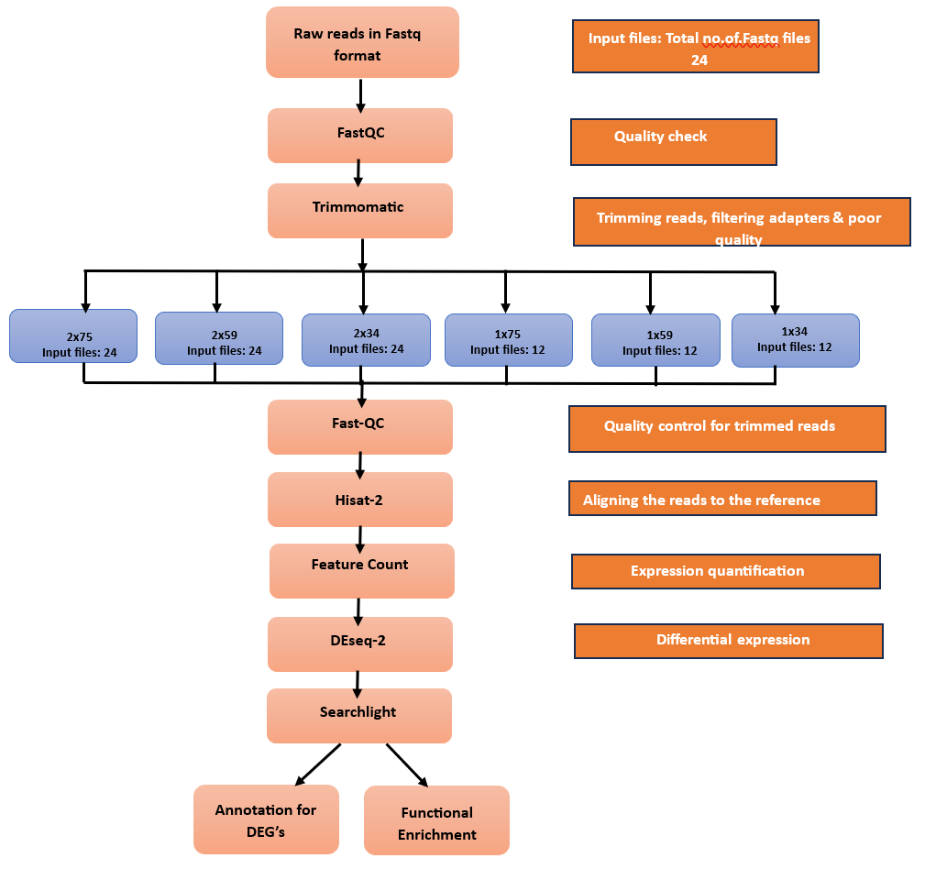
Overall Workflow
Datasets:
Organism: Arabidopsis thaliana
Genotype: Histone Deacetylation Complex 1 (HDC1) and Knock-out (KO)
Experimental conditions: HDC1control,HDC1salt,KOcontrol and KOsalt
No. of. replicates: 3 each
Total samples:12
GEO accession no: GSE205893
Reference genome: Arabidopsis thaliana (TAIR10.1).
Cutoff used:
Pvalue <0.05
Log2 Fold change -1< FC >1
Ref.genome gtt/gtf file

Slide 5
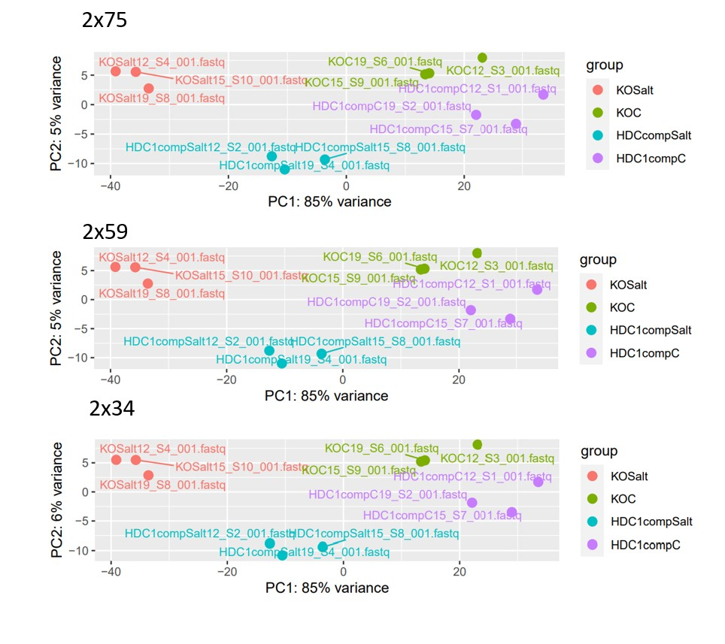
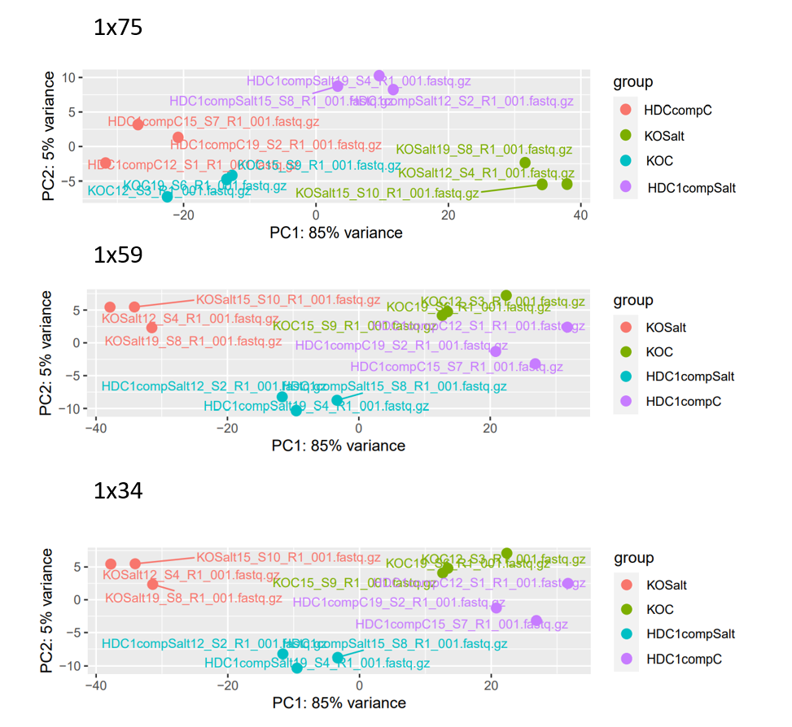
What did we observe?
Did the read length affect the clustering of samples?
a.
a.
b.
b.
c.
c.
PCA plot comparison for different read lengths across paired-end and single-end.

Slide 6
Did the read length affect the DEG?

Slide 7
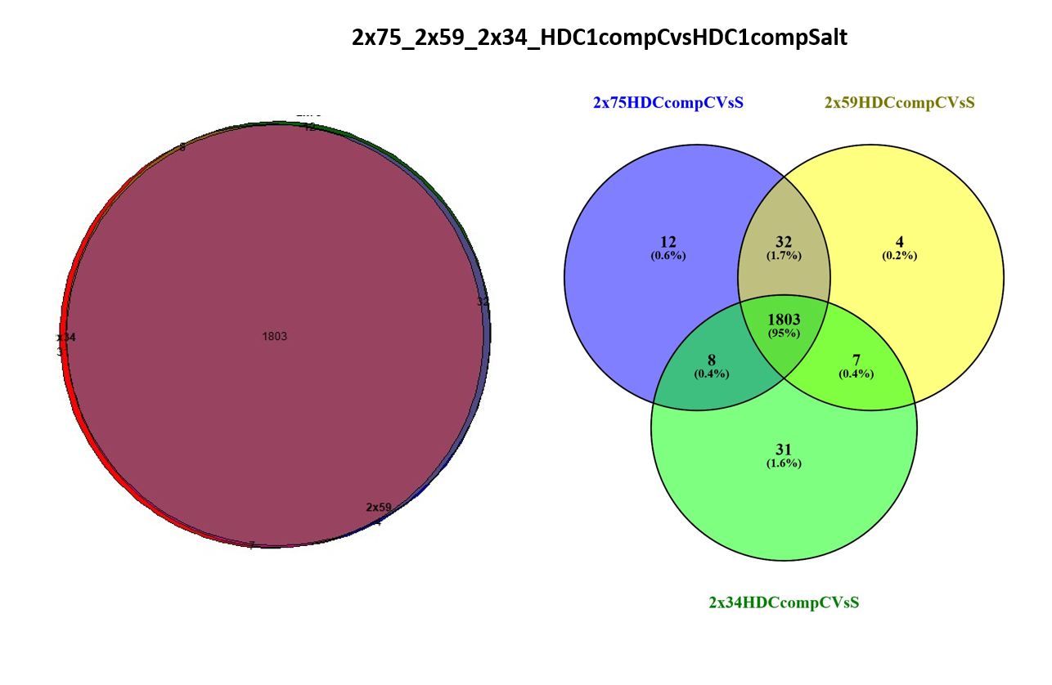
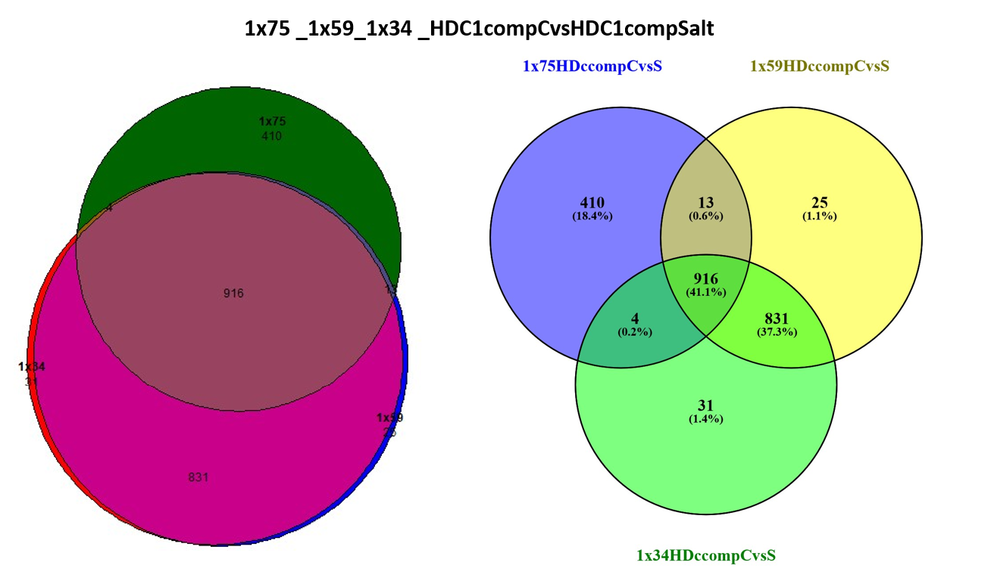
Analysing the correlation with the golden standard 2x75
PE overlapping is higher
SE -deviates
Note: Similar results were observed in the KO comparison of paired-end and single-end datasets which is 97.3% and 96.1%

Slide 8
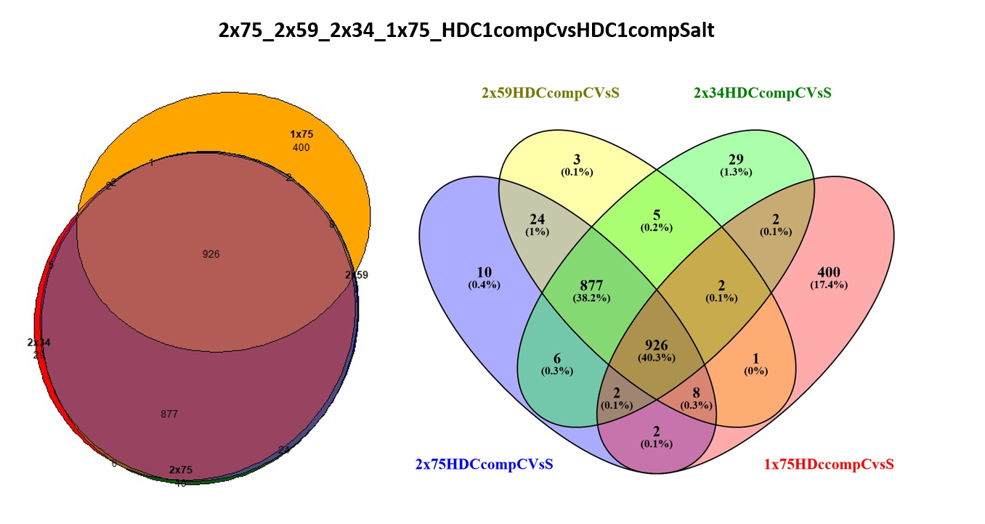
SE overlaps with 2x75 is lower
PE overlaps with 2x75 is higher
Note: Similar results were observed in the KO comparison datasets.

Slide 9
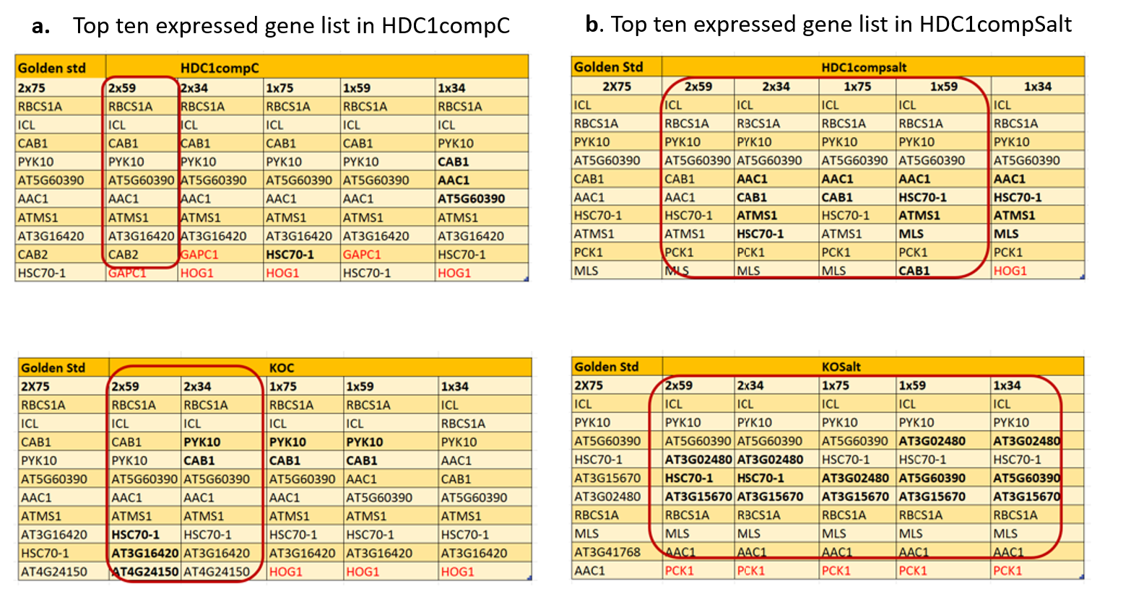
Analysing the most expressed genes of DEG with the golden standard 2x75
c. Top ten expressed gene list in KOC
d. Top ten expressed gene list in KOC

Slide 10
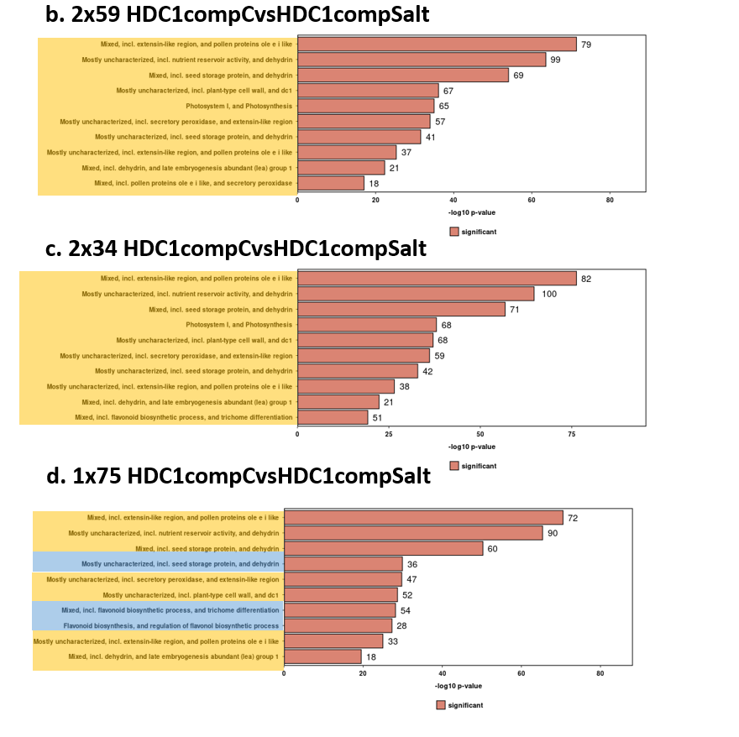
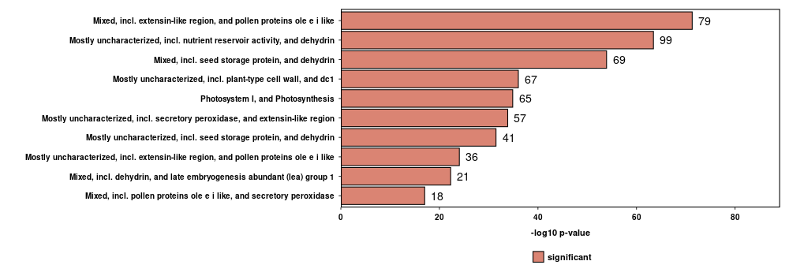
Comparison of Gene ontologies of top 10 DEG’s with the golden standard 2x75- based on pvalue
a. 2x75 HDC1compCvsHDC1compSalt

Slide 11
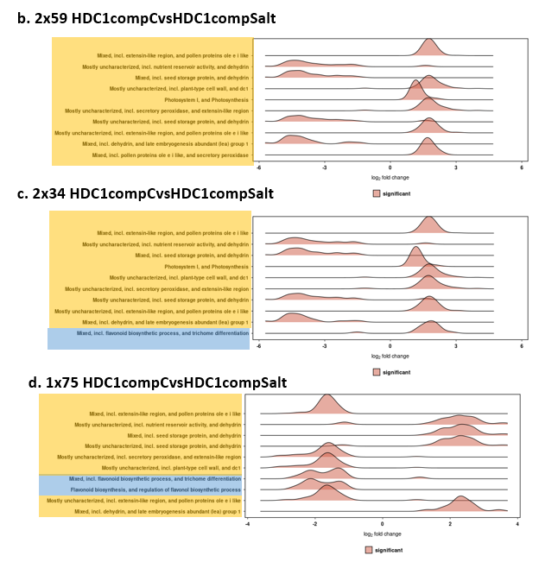
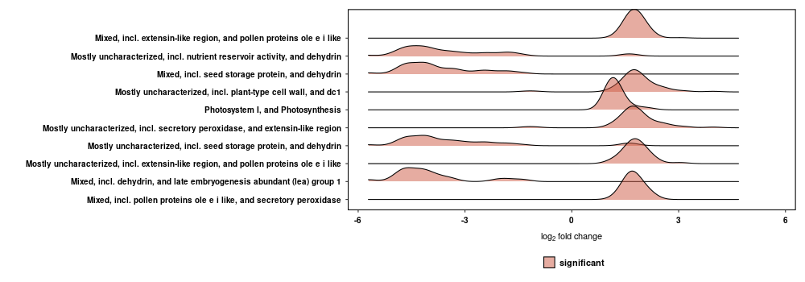
Comparison of Gene ontologies of top 10 DEG’s with the golden standard 2x75- based on log fold change
a. 2x75 HDC1compCvsHDC1compSalt

Slide 12
Key Takeaways:
2x75 , could be replaced with 2x59.
Cost-effective alternate.
No compromise in the standard of the result.
We can suggest 100 cycle kit instead of 200 cycle kit for the Nextseq200.
PE performed well than the SE.
Limitations:
Single Data Set Limitation
Organism-Specific Results
Future works:
The ideal scenario involves testing multiple datasets and various model organisms.

Slide 13


